Slide 1
EXPLORING FANDANGO DISPLAYED SCORES VERSUS TRUE USER RATINGS
CAPSTONE PROJECT
Presented By:
Mohamed Salahudeen Ayyub R
B.E GEOINFORMATICS ENGINEERING
Park College of Engineering and Technology

Slide 2
OUTLINE
Problem Statement
Proposed System/Solution
System Development Approach
Algorithm & Deployment
Result
Conclusion
Future Scope
References

Slide 3
PROBLEM STATEMENT
Explore the relationship between popularity of a film and its rating

Slide 4
PROPOSED SOLUTION
Explore the relationship between popularity of a film and its rating
A scatterplot showing the relationship between rating and votes

Slide 5
SYSTEM APPROACH
Jupiter notebook

Slide 6
ALGORITHM & DEPLOYMENT
Comparison of Fandango Ratings to Other Sites
a scatterplot exploring the relationship between RT Critic reviews and RT User reviews
Calculate the Mean Absolute Difference between RT scores and RT User scores as described above
create a distribution showing the absolute value difference between Critics and Users on Rotten Tomatoes.
Display a scatterplot of the Metacritic Rating versus the Metacritic User rating.

Slide 7
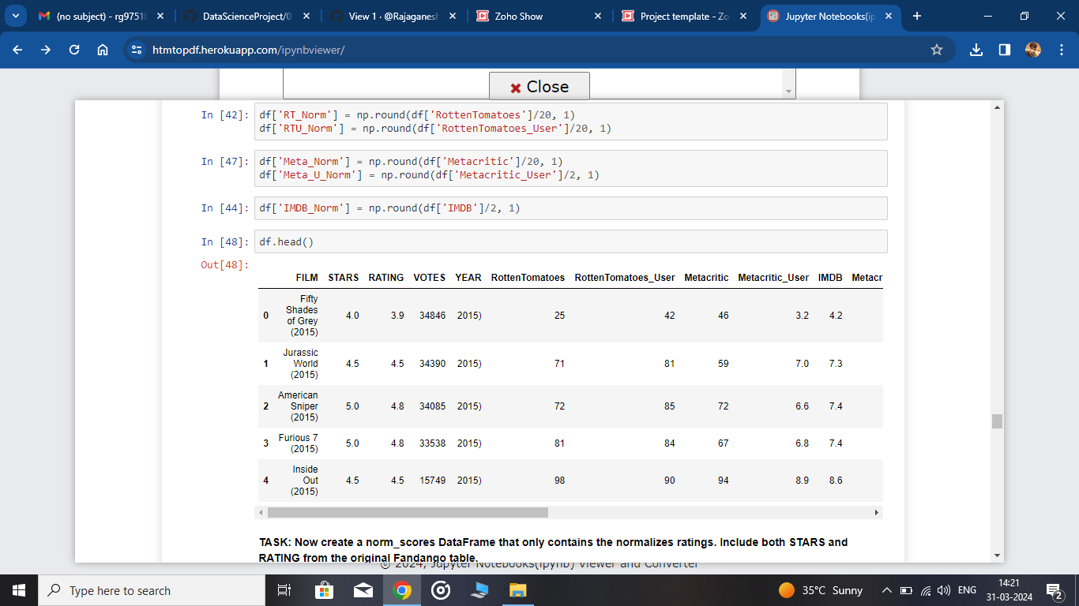
RESULT
Find a movie original ratings and find the scam

Slide 8
CONCLUSION
We can save the money and dont go into the scam

Slide 9
FUTURE SCOPE
It will save the movie and escape from scam websites

Slide 10
REFERENCES
Reference from kaggle website

Slide 11
THANK YOU

